Slide 1
District Work Status
Taluka | Category | No. of Schemes | Work Order Issued | Work In Progress | Work Not Started
Akole | Retro | 64 | 64 | 40 | 24
 | New | 30 | 29 | 18 | 11
Kopargaon | Retro | 33 | 32 | 26 | 6
 | New | 19 | 19 | 19 | 0
Rahata | Retro | 20 | 18 | 17 | 1
 | New | 9 | 9 | 9 | 0
Sangamner | Retro | 49 | 49 | 29 | 20
 | New | 23 | 23 | 12 | 11
Total | Retro | 166 | 163 | 112 | 50
 | New | 81 | 80 | 58 | 22
Grand Total |  | 247 | 243 | 170 | 73

Slide 2
Executive Summary Work in Progress Schemes
Taluka | Category | Total No. of Schemes | No. of Schemes based on Physical Progress %
 |  |  | < 25% | 25 < 50% | 50 < 75% | 75 < 100% | Commissioned
Akole | Retro | 40 | 28 | 9 | 1 | 2 | 0
 | New | 18 | 16 | 2 | 0 | 0 | 0
Kopargaon | Retro | 26 | 12 | 10 | 2 | 2 | 0
 | New | 19 | 6 | 7 | 3 | 3 | 0
Rahata | Retro | 17 | 6 | 6 | 1 | 0 | 4
 | New | 9 | 5 | 1 | 2 | 1 | 0
Sangamner | Retro | 29 | 11 | 11 | 4 | 0 | 3
 | New | 12 | 6 | 4 | 1 | 1 | 0
Total | Retro | 112 | 57 | 36 | 8 | 4 | 7
 | New | 58 | 33 | 14 | 6 | 5 | 0
Grand Total |  | 170 | 90 | 50 | 14 | 9 | 7

Slide 3
Abstract of Schemes – Work in Progress Category – “Retro”
Sr No | Scheme Name | Name of Agency | W.O. Amount (excl GST) | W.O. Date | Construction Period | Physical Progress
Akole Taluka | Akole Taluka
1 | Shiswad | Uttam Bhausaheb Navale | 1,23,17,471 | 27-10-2022 | 12 Months | 80.00%
2 | Chas | Shree Ganesh Construction | 1,50,47,358 | 12-10-2022 | 12 Months | 75.00%
3 | Samrad | Ambadas Popat Ghuge | 1,28,85,722 | 14-10-2022 | 12 Months | 50.00%
4 | Savarkute | Uttam Bhausaheb Navale | 1,57,04,093 | 27-10-2022 | 12 Months | 40.00%
5 | Sherankhel | Ambadas Popat Ghuge | 1,71,41,763 | 07-11-2022 | 12 Months | 38.00%
6 | Udadawane | Rohan S Mande Engineers And Contractors | 2,47,48,285 | 31-10-2022 | 12 Months | 33.00%
7 | Kohandi | Bhabad Sanjay Dadasaheb | 93,92,568 | 14-10-2022 | 12 Months | 32.00%
8 | Chinchvane | Krushna Infrastructure | 1,27,12,248 | 07-11-2022 | 12 Months | 30.00%
9 | Jamgaon | Adesh Gorkshnath Yevale | 93,33,165 | 07-11-2022 | 12 Months | 30.00%
10 | Sakirwadi | M/S Sai Constructions | 1,67,57,801 | 12-10-2022 | 12 Months | 30.00%
11 | Shelad | Bhabad Sanjay Dadasaheb | 2,26,73,447 | 28-11-2022 | 12 Months | 30.00%
12 | Ranad Bk. & Kh. | Ambadas Popat Ghuge | 1,49,22,255 | 07-11-2022 | 12 Months | 25.00%
13 | Kautewadi | Somnath Nivrutti Thorat | 47,87,273 | 13-09-2022 | 12 Months | 20.00%

Slide 4
Abstract of Schemes – Work in Progress Category – “Retro”
Sr No | Scheme Name | Name of Agency | W.O. Amount (excl GST) | W.O. Date | Construction Period | Physical Progress
14 | Khadaki Bk Kh | Kiran Sukhdev Gavhane | 1,05,08,000 | 21-12-2022 | 12 Months | 20.00%
15 | Katalapur | Satyajit Balasaheb Arote | 91,47,664 | 21-11-2022 | 12 Months | 15.00%
16 | Shenit | Jitendra V Patil | 92,96,679 | 19-09-2022 | 12 Months | 15.00%
17 | Titvi | Bhabad Sanjay Dadasaheb | 1,68,79,885 | 01-11-2022 | 12 Months | 15.00%
18 | Bhandardara | Somnath Nivrutti Thorat | 65,41,574 | 10-10-2022 | 12 Months | 10.00%
19 | Paithan | Uttam Bhausaheb Navale | 1,58,33,288 | 20-10-2022 | 12 Months | 10.00%
20 | Jambhale | Uttam Bhausaheb Navale | 2,13,56,409 | 17-01-2023 | 12 Months | 6.00%
21 | Bori | M/S Sai Constructions | 1,44,41,618 | 06-10-2022 | 12 Months | 5.00%
22 | Lavali Otur | Krushna Infrastructure | 3,41,77,960 | 29-09-2022 | 12 Months | 5.00%
23 | Shelvihire | Satyajit Balasaheb Arote | 93,61,547 | 11-11-2022 | 12 Months | 5.00%
24 | Shirpunje Bk | M/S Sai Constructions | 1,18,49,836 | 12-10-2022 | 12 Months | 5.00%
25 | Tirade | Dinesh Jadhav | 3,07,13,750 | 28-11-2022 | 12 Months | 5.00%
26 | Tahakari | Uttam Bhausaheb Nawale | 72,97,000 | 30-06-2022 | 12 Months | 5.00%
27 | Bholewadi | M/S Sai Constructions | 86,37,053 | 12-10-2022 | 12 Months | 4.00%

Slide 5
Abstract of Schemes – Work in Progress Category – “Retro”
Sr No | Scheme Name | Name of Agency | W.O. Amount (excl GST) | W.O. Date | Construction Period | Physical Progress
28 | Kotul | Jalindar Davkhar | 4,47,30,428 | 03-10-2022 | 12 Months | 4.00%
29 | Pimaprkane | Bhabad Sanjay Dadasaheb | 1,75,15,033 | 27-10-2022 | 12 Months | 4.00%
30 | Waki | Jitrendra V Patil | 1,10,57,858 | 19-09-2022 | 12 Months | 4.00%
31 | Wanjulshet | Uttam Bhausaheb Navale | 1,74,28,514 | 30-06-2022 | 12 Months | 4.00%
32 | Chaitanyapur | Uttam Bhausaheb Navale | 1,75,52,820 | 20-10-2022 | 12 Months | 3.00%
33 | Devgaon | B M Infrastructure | 1,24,61,326 | 25-10-2022 | 12 Months | 3.00%
34 | Karandi | Omkar Ramdas Gite | 1,34,59,045 | 14-10-2022 | 12 Months | 3.00%
35 | Keli Rumhanwadi | Bhabad Sanjay Dadasaheb | 1,62,03,044 | 13-09-2022 | 12 Months | 3.00%
36 | Kokanwadi | Satyajit Balasaheb Arote | 1,12,96,660 | 19-09-2022 | 12 Months | 3.00%
37 | Lahit Kd | Uttam Bhausaheb Navale | 1,22,76,599 | 20-10-2022 | 12 Months | 3.00%
38 | Nachanthav | Krushna Infrastructure | 82,81,455 | 12-10-2022 | 12 Months | 3.00%
39 | Sangvi | Uttam Bhausaheb Navale | 1,57,19,200 | 07-11-2022 | 12 Months | 3.00%
40 | Malegaon | Onkar Construction | 1,00,00,828 | 07-12-2022 | 12 Months | 2.00%

Slide 6
Abstract of Schemes – Work in Progress Category – “Retro”
Sr No | Scheme Name | Name of Agency | W.O. Amount (excl GST) | W.O. Date | Construction Period | Physical Progress
Kopargaon Taluka | Kopargaon Taluka
41 | Nategaon | Shree Pavan Construction | 95,65,662 | 04-05-2022 | 12 Months | 80.00%
42 | Bramhangaon | Mauli | 1,22,85,321 | 18-10-2022 | 12 Months | 75.00%
43 | Bhojade | Anil Kandalkar | 62,13,642 | 28-09-2022 | 12 Months | 70.00%
44 | Sonari | Piyush Salve | 94,56,000 | 22-11-2022 | 12 Months | 55.00%
45 | Ogadi | Lalit Shantaram Joshi | 54,16,688 | 06-05-2022 | 12 Months | 45.00%
46 | Derdechandwad | Shramsafalya Construction | 20,72,949 | 28-03-2022 | 12 Months | 40.00%
47 | Savanstar | K.K. Thorat | 2,65,72,834 | 18-10-2022 | 12 Months | 40.00%
48 | Morvis | Shree Devolopers | 97,18,863 | 15-12-2022 | 12 Months | 40.00%
49 | Karwadi | Shree Devolopers | 2,32,25,033 | 15-06-2022 | 12 Months | 35.00%
50 | Bhaktarpur | Lalit Shantaram Joshi | 23,50,364 | 13-07-2022 | 12 Months | 35.00%
51 | Shahajapur | Anil Kandalkar | 32,15,494 | 28-09-2022 | 12 Months | 30.00%
52 | Vadgaon | Lalit Shantaram Joshi | 40,46,175 | 26-06-2022 | 12 Months | 30.00%
53 | Dauch Bk | Vikas Shantaram Sangale | 60,85,598 | 28-07-2022 | 12 Months | 25.00%

Slide 7
Abstract of Schemes – Work in Progress Category – “Retro”
Sr No | Scheme Name | Name of Agency | W.O. Amount (excl GST) | W.O. Date | Construction Period | Physical Progress
54 | Mahegaon Deshmukh | Cholke Sanjay Parasram | 23,50,364 | 20-07-2022 | 12 Months | 25.00%
55 | Padhegaon | Lalit Shantaram Joshi | 62,73,875 | 17-02-2022 | 12 Months | 20.00%
56 | Manjur | Lalit Shantaram Joshi | 57,63,170 | 22-11-2022 | 12 Months | 15.00%
57 | Apegaon | Lalil Shantaram Joshi | 96,58,694 | 13-07-2022 | 12 Months | 14.47%
58 | Pohegaon | K.K. Thorat | 3,53,13,046 | 30-09-2022 | 12 Months | 10.00%
59 | Karanji Budruk | Sachin Lande | 1,62,67,443 | 18-11-2022 | 12 Months | 10.00%
60 | Ghari | Rajendra Beldar | 67,98,719 | 06-10-2022 | 12 Months | 5.00%
61 | Khopadi | Mauli Infrastructures | 43,16,188 | 06-10-2022 | 12 Months | 5.00%
62 | Sade | Shivam Creation | 25,96,683 | 13-07-2022 | 12 Months | 5.00%
63 | Ukkadgaon | Rajendra Beldar | 18,85,352 | 05-07-2022 | 12 Months | 5.00%
64 | Khindi Ganesh | Shree Pavan Construction | 77,95,536 | 04-05-2022 | 12 Months | 5.00%
65 | Kolgaon Thadi | Cholke Sanjay Parasram | 69,39,113 | 28-09-2022 | 12 Months | 5.00%
66 | Ghoyegaon | Rajendra Beldar | 29,61,803 | 06-10-2022 | 12 Months | 2.00%

Slide 8
Abstract of Schemes – Work in Progress Category – “Retro”
Sr No | Scheme Name | Name of Agency | W.O. Amount (excl GST) | W.O. Date | Construction Period | Physical Progress
Rahata Taluka | Rahata Taluka
67 | Jalgaon | Prakash Mangu Pawar | 1,67,53,956 | 29-07-2022 | 12 Months | 60.00%
68 | Dahigaon Korhale | Prakash Mangu Pawar | 25,57,078 | 29-06-2022 | 3 Months | 38.00%
69 | Nimgaon Korhale | Rajendra Pandhore | 38,42,646 | 19-08-2022 | 12 Months | 37.00%
70 | Durgapur | Sankalp Ganesh | 1,11,24,414 | 07-11-2022 | 12 Months | 35.00%
71 | Hasnapur | Sharad Gholap | 1,58,59,747 | 19-08-2022 | 12 Months | 35.00%
72 | Nandurkhi Bk | Shubham Dandwate | 1,33,23,600 | 10-11-2022 | 12 Months | 29.00%
73 | Ranjangaon Khurd | Prakash Mangu Pawar | 1,11,64,666 | 19-08-2022 | 12 Months | 25.00%
74 | Nandurkhi Kh | Cholke Sanjay | 76,66,767 | 09-09-2022 | 12 Months | 7.00%
75 | Ekrukhe | B B Lahamge | 3,01,09,271 | 15-02-2023 | 12 Months | 5.00%
76 | Pimpri Nirmal | Dadasaheb Dhavne | 3,97,16,628 | 11-11-2022 | 12 Months | 5.00%
77 | Cholkewadi , Morwadi Tarkaswadi | B S Bhujbal | 1,36,01,409 | 27-12-2022 | 12 Months | 2.00%
78 | Chitali | Ravindra Sahebrao Shinde | 1,58,71,211 | 10-06-2022 | 12 Months | 2.00%
79 | Rajuri | Dadasaheb Dhavne | 4,29,37,910 | 19-12-2022 | 12 Months | 2.00%

Slide 9
Abstract of Schemes – Work in Progress Category – “Retro”
Sr No | Scheme Name | Name of Agency | W.O. Amount (excl GST) | W.O. Date | Construction Period | Physical Progress
Sangamner Taluka | Sangamner Taluka
80 | Devgaon | B S Bhujbal | 1,51,60,116 | 03-08-2022 | 12 Months | 60.00%
81 | Kokangaon | Sachin Biru Rahinj | 1,05,84,254 | 27-09-2022 | 12 Months | 60.00%
82 | Pratappur | Yogiraj Infra | 1,58,02,565 | 11-11-2022 | 12 Months | 60.00%
83 | Waghapur | Shree Kolhe Umesh | 1,10,06,558 | 03-08-2022 | 12 Months | 50.00%
84 | Jakhuri | Anil Kandalkar | 1,71,43,721 | 27-06-2022 | 12 Months | 40.00%
85 | Pimpalgoan Konzira | R D Thorat | 1,11,24,124 | 06-10-2022 | 12 Months | 35.00%
86 | Digras | B S Bhujbal | 4,02,41,197 | 03-10-2022 | 12 Months | 30.00%
87 | Pimparne | Jorvekr | 2,96,59,399 | 07-11-2022 | 12 Months | 30.00%
88 | Rahimpur (Bhagawat Wasti, Gaothan, Thakarwadi) | Sanket Enterprises | 1,67,34,290 | 30-09-2022 | 12 Months | 30.00%
89 | Wadgaon Landga | M/S J.D. Dighe And Sons | 3,02,20,390 | 10-06-2022 | 12 Months | 30.00%
90 | Umbari | K.K. Thorat | 1,59,20,602 | 15-02-2022 | 12 Months | 30.00%
91 | Konchi Manchi | Santosh Pandharinath Jondhale | 84,14,669 | 10-11-2022 | 12 Months | 30.00%

Slide 10
Abstract of Schemes – Work in Progress Category – “Retro”
Sr No | Scheme Name | Name of Agency | W.O. Amount (excl GST) | W.O. Date | Construction Period | Physical Progress
92 | Manoli | B S Bhujbal | 1,65,15,444 | 03-08-2022 | 12 Months | 25.00%
93 | Ashwi Bk. | Shree Devolopers | 1,73,84,181 | 17-10-2022 | 12 Months | 25.00%
94 | Sangavi | R D Thorat | 82,12,612 | 10-06-2022 | 12 Months | 25.00%
95 | Kharadi | Krushna Infrastructure | 1,28,27,862 | 11-07-2022 | 12 Months | 20.00%
96 | Kankapur | Radhakrushna Construction Company | 86,73,959 | 09-09-2022 | 12 Months | 20.00%
97 | Birewadi | Yashwant Sambhaji Kandalkar | 1,77,93,150 | 18-10-2022 | 12 Months | 20.00%
98 | Balapur | Krushna Infrastructure | 1,72,06,048 | 11-01-2022 | 12 Months | 15.00%
99 | Shedgaon | Sanket Enterprises | 16,99,603 | 05-12-2022 | 12 Months | 10.00%
100 | Shibalapur | Radhakrushna Construction Company | 1,17,85,570 | 14-09-2022 | 12 Months | 10.00%
101 | Jambut Kh. | Yashwant Sambhaji Kandalkar | 1,76,49,604 | 21-09-2022 | 12 Months | 10.00%
102 | Pimpari Lokai Ajampur | M/S Vihan Construction | 1,74,01,481 | 12-12-2022 | 12 Months | 10.00%
103 | Ghargaon | Krushna Infrastructure | 85,94,988 | 11-07-2022 | 12 Months | 10.00%
104 | Jambhulwadi | Krushna Infrastructure | 4,39,23,872 | 11-01-2022 | 12 Months | 10.00%
105 | Kanoli | Dadasaheb Dhavane | 2,67,82,416 | 28-11-2022 | 12 Months | 6.00%

Slide 11
Abstract of Schemes – Work in Progress Category – “New”
Sr No | Scheme Name | Name of Agency | W.O. Amount (excl GST) | W.O. Date | Construction Period | Physical Progress
Akole Taluka | Akole Taluka
1 | Keli Otur | Shree Ganesh Construction | 3,50,58,000 | 06-01-2023 | 12 Months | 40.00%
2 | Terungan | Prajakt Rajesh Kadam | 1,18,37,066 | 04-11-2022 | 12 Months | 35.00%
3 | Ambit | Shree Ganesh Construction | 1,41,89,678 | 10-01-2023 | 12 Months | 20.00%
4 | Pimpaldari | M/S J. D. Dighe And Sons | 1,56,56,240 | 07-11-2022 | 12 Months | 20.00%
5 | Ghatghar | Sunil Ramnath Mandlik | 1,29,43,127 | 06-10-2022 | 12 Months | 13.00%
6 | Pachnai | Walunj Ashok Paraji | 68,27,369 | 07-11-2022 | 12 Months | 10.00%
7 | Khirvire | Ambadas Popat Ghuge | 3,62,20,125 | 27-01-2022 | 12 Months | 6.00%
8 | Chitalvedhe | Somnath Nivrutti Thorat | 65,76,477 | 25-10-2022 | 12 Months | 5.00%
9 | Pachpattawadi | Ambadas Popat Ghuge | 94,76,841 | 10-10-2022 | 12 Months | 5.00%
10 | Pangri | Uttam Bhausaheb Navale | 1,53,67,986 | 20-10-2022 | 12 Months | 5.00%
11 | Ratanawadi | Uttam Bhausaheb Nawale | 1,93,34,084 | 15-12-2022 | 12 Months | 5.00%
12 | Somalwadi | Godse Prajwal Somnath | 1,31,16,000 | 15-12-2022 | 12 Months | 5.00%
13 | Digambar | Adesh Gorkshnath Yevale | 83,53,362 | 28-11-2022 | 12 Months | 4.00%

Slide 12
Abstract of Schemes – Work in Progress Category – “New”
Sr No | Scheme Name | Name of Agency | W.O. Amount (excl GST) | W.O. Date | Construction Period | Physical Progress
14 | Murshet | Bharat Popat Pardhi | 1,09,62,120 | 17-01-2023 | 12 Months | 4.00%
15 | Abitkhind | Bharat Popat Pardhi | 1,24,50,507 | 06-12-2022 | 12 Months | 3.00%
16 | Mhalungi | Vishal Bodkhe | 1,66,52,670 | 17-01-2023 | 12 Months | 3.00%
17 | Pnjare | Prajakt Rajesh Kadam | 67,32,672 | 20-10-2022 | 12 Months | 2.00%
18 | Pendshet | Satyajit Balasaheb Arote | 90,58,023 | 15-12-2022 | 12 Months | 2.00%
Kopargaon Taluka | Kopargaon Taluka
19 | Darde Korale | Shramsafalya Construction | 1,88,27,550 | 30-03-2022 | 12 Months | 95.00%
20 | Talegaonmale | Shramsafalya Construction | 1,84,90,537 | 06-05-2022 | 12 Months | 95.00%
21 | Takali | Prashant Dahifale | 26,77,363 | 27-06-2022 | 12 Months | 80.00%
22 | Dahigaon Bolka | Shree Pavan Construction | 61,08,983 | 11-10-2022 | 12 Months | 70.00%
23 | Tilwani | Pande Ujjwal | 17,18,540 | 16-11-2022 | 12 Months | 50.00%
24 | Bolaki | Akshay Eknath Chaudari | 48,41,631 | 12-12-2022 | 12 Months | 50.00%
25 | Madhi Khu | Ramakant Phad | 79,50,959 | 23-11-2022 | 12 Months | 45.00%
26 | Dauch Kh | Lalit Shantaram Joshi | 80,20,163 | 28-09-2022 | 12 Months | 42.00%

Slide 13
Abstract of Schemes – Work in Progress Category – “New”
Sr No | Scheme Name | Name of Agency | W.O. Amount (excl GST) | W.O. Date | Construction Period | Physical Progress
27 | Sangavi Bhusar | Anil Kandalkar | 50,63,286 | 16-06-2022 | 12 Months | 42.00%
28 | Sonewadi | Anil Kandalkar | 4,16,60,683 | 28-09-2022 | 12 Months | 40.00%
29 | Anchalgaon | Rajendra Beldar | 55,11,518 | 06-10-2022 | 12 Months | 38.00%
30 | Chandekasare | Dhomse Shivam Pandurang | 35,21,732 | 06-12-2022 | 12 Months | 30.00%
31 | Dhotre | Lalit Shantaram Joshi | 1,32,29,742 | 24-06-2022 | 12 Months | 25.00%
32 | Shahapur | B J Samudra | 1,66,64,154 | 18-10-2022 | 12 Months | 20.00%
33 | Madhi Bu | Ramakant Phad | 1,33,91,790 | 31-05-2022 | 12 Months | 10.00%
34 | Jawalke | B J Samudra | 1,64,09,783 | 17-10-2022 | 12 Months | 10.00%
35 | Lauki | Lalit Shantaram Joshi | 51,62,439 | 17-02-2022 | 12 Months | 5.00%
36 | Kasali | Prashant Dahifale | 32,10,118 | 12-12-2022 | 12 Months | 5.00%
37 | Handewadi | Anil Kandalkar | 63,42,339 | 28-09-2022 | 12 Months | 5.00%
Rahata Taluka | Rahata Taluka
38 | Nighoj | Cholke Sanjay Parasram | 63,62,220 | 26-07-2022 | 12 Months | 85.00%
39 | Kankuri | Shivam Kailas Gholap | 89,81,841 | 08-01-2022 | 12 Months | 70.00%

Slide 14
Abstract of Schemes – Work in Progress Category – “New”
Sr No | Scheme Name | Name of Agency | W.O. Amount (excl GST) | W.O. Date | Construction Period | Physical Progress
40 | Sawalivihir Bk | M P Totare | 1,65,48,491 | 08-01-2022 | 12 Months | 50.00%
41 | Adgaon Bk. | Dadasaheb Dhavne | 4,16,31,788 | 30-01-2023 | 12 Months | 25.00%
42 | Tisgaon | K K Thorat | 47,95,296 | 09-06-2022 | 12 Months | 20.00%
43 | Dhangarwadi | Akshay Tambe | 97,13,164 | 11-11-2022 | 12 Months | 2.00%
44 | Nandur Bk | Cholke Sanjay Parasram | 3,98,06,027 | 12-08-2022 | 12 Months | 2.00%
45 | Astagaav | Dadasaheb Dhavne | 3,92,35,175 | 12-05-2022 | 12 Months | 2.00%
46 | Babhaleshwar | Ravindra Sahebrao Shinde | 2,17,72,115 | 27-10-2022 | 12 Months | 2.00%
Sangamner Taluka | Sangamner Taluka
47 | Modhalwadi | Shree Sachin Jorvekr | 1,10,98,315 | 27-06-2022 | 12 Months | 75.00%
48 | Borbanwadi | Kiran Gadge | 1,05,49,057 | 14-06-2022 | 12 Months | 70.00%
49 | Kolwade | Anil Kandalkar | 2,03,89,563 | 30-06-2022 | 12 Months | 40.00%
50 | Raytewadi | Y A Kandalkar | 1,75,03,472 | 18-10-2022 | 12 Months | 40.00%
51 | Ozar Bk | M/S Sanket Enterprises | 1,67,19,198 | 30-09-2022 | 12 Months | 40.00%
52 | Dhandarphal Kh | Krushna Infrastructure | 1,46,87,866 | 16-09-2022 | 12 Months | 30.00%

Slide 15
Abstract of Schemes – Work in Progress Category – “New”
Sr No | Scheme Name | Name of Agency | W.O. Amount (excl GST) | W.O. Date | Construction Period | Physical Progress
53 | Kurakundi | K.K. Thorat | 1,52,92,673 | 31-10-2022 | 12 Months | 20.00%
54 | Dadh Kh | M/S Atul Rmc | 1,68,19,994 | 27-09-2022 | 12 Months | 20.00%
55 | Chanegaon | B S Bhujbal | 1,68,71,291 | 08-09-2022 | 12 Months | 10.00%
56 | Mhaswandi | G D Dighe | 97,75,956 | 11-10-2022 | 12 Months | 10.00%
57 | Nimbale | Kolhe Yogesh | 1,30,41,711 | 01-11-2022 | 12 Months | 10.00%
58 | Pemrewadi | Ankita Dilip Shinde | 65,84,312 | 09-08-2022 | 12 Months | 10.00%

Slide 16
Abstract of Schemes – Work Completed Category – “Retro”
Sr No | Scheme Name | Name of Agency | W.O. Amount (excl GST) | W.O. Date | Construction Period
Rahata Taluka | Rahata Taluka
1 | Chandrapur | Cholke Sanjay Parasram | 20,89,996 | 14-06-2022 | 3 Months
2 | Pimplas | Ghungare Sukhdev Namdev | 20,28,281 | 25-04-2022 | 3 Months
3 | Rastapur | Cholke Sanjay Parasram | 14,92,462 | 28-03-2022 | 3 Months
4 | Sawalivihir Kh | Cholke Sanjay Parasram | 20,30,047 | 05-04-2022 | 3 Months
Sangamner Taluka | Sangamner Taluka
5 | Khali | Shramsafalya Construction | 16,37,301 | 25-04-2022 | 12 Months
6 | Ozar Kh | Advet Construction | 58,62,171 | 17-03-2022 | 12 Months
7 | Zarekhati | Shramsafalya Construction | 12,00,594 | 21-02-2022 | 12 Months

Slide 17
DASHBOARD

Slide 18
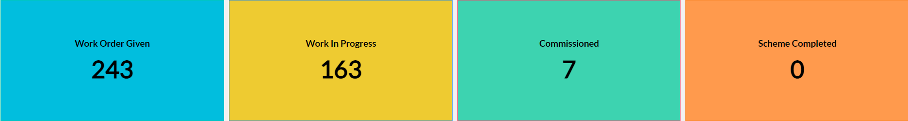
Dashboard
Work Status

Slide 19
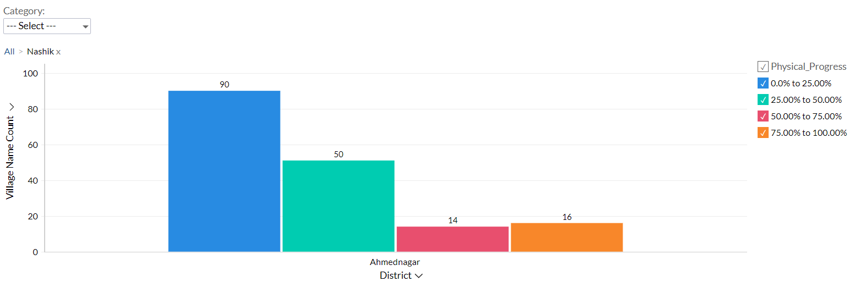
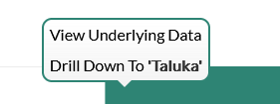
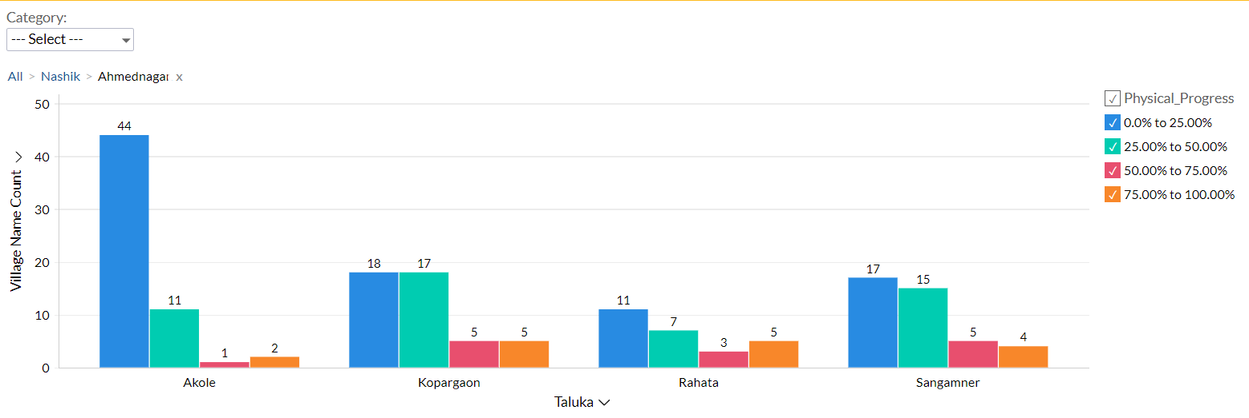
Dashboard
Progress Milestone

Slide 20
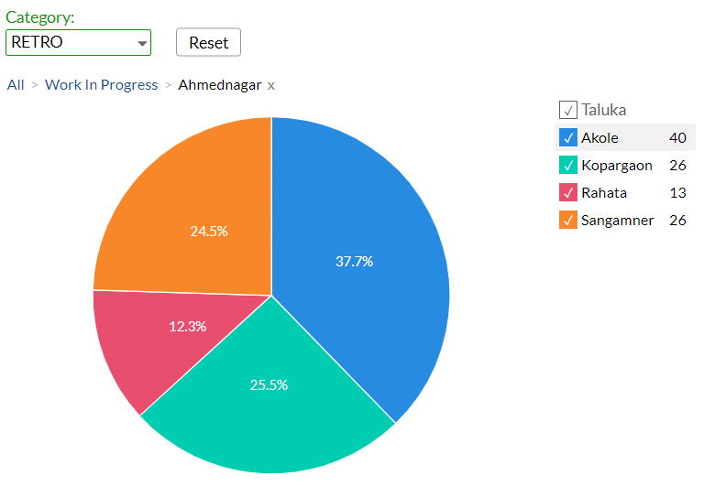
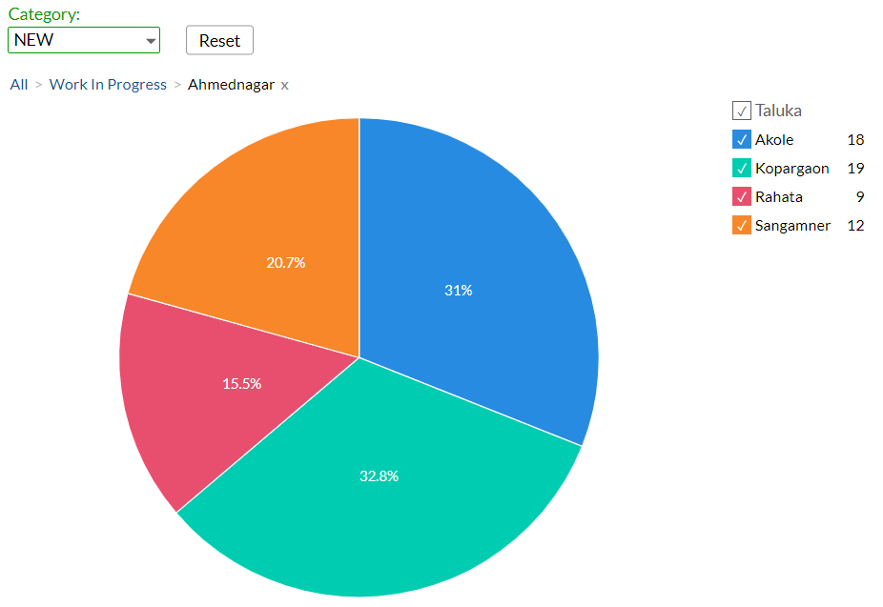
Dashboard
Work Status: ”Retro Schemes”
Work Status: “New Schemes”

Slide 21
MS – PROJECT
Work in Progress Schemes

Slide 22
Project Overview Physical Progress vs Financial Progress vs Time Overrun

Slide 23
Late Schemes

Slide 24
SAMPLE SITE VISIT PHOTOS

Slide 25
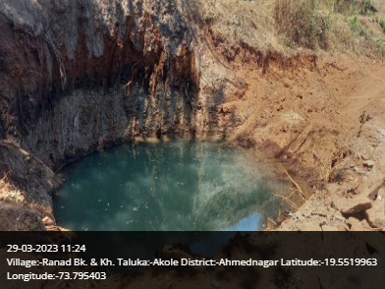
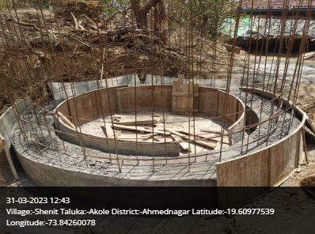
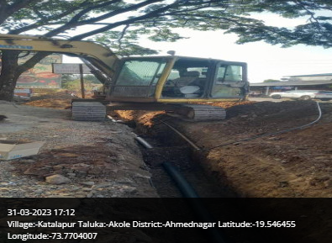
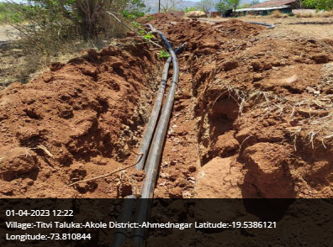
Akole Taluka

Slide 26
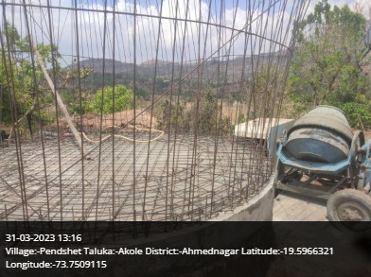
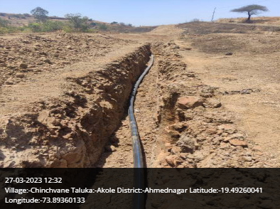
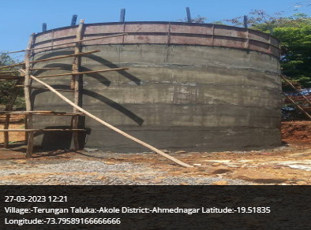
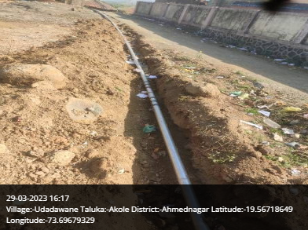
Akole Taluka

Slide 27
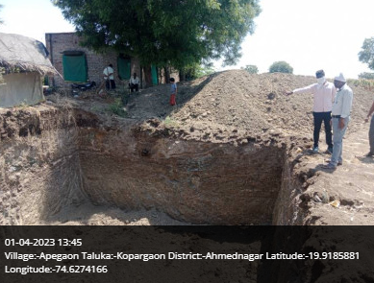
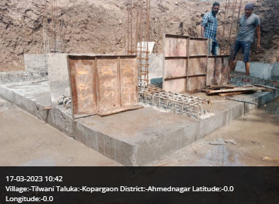
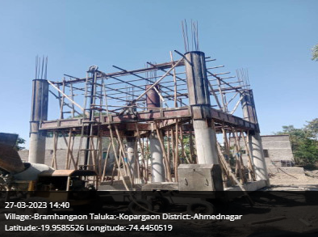
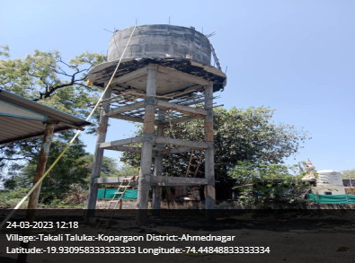
Kopargaon Taluka

Slide 28
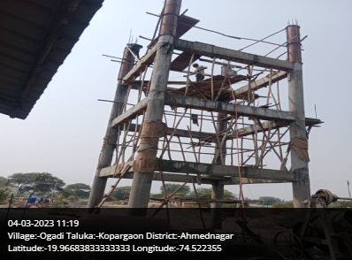
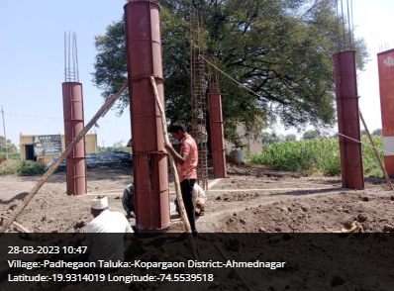
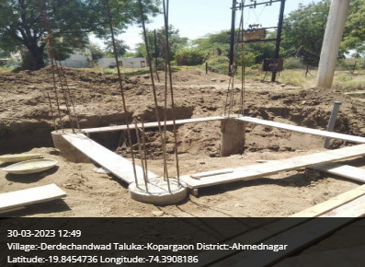
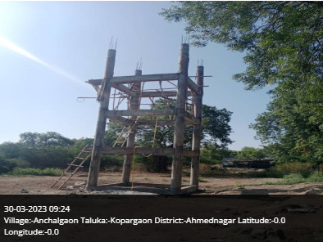
Kopargaon Taluka

Slide 29
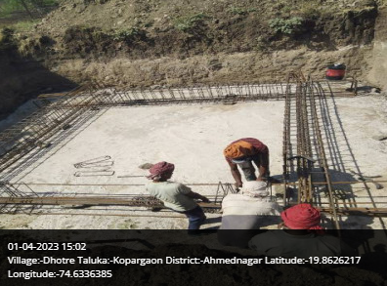
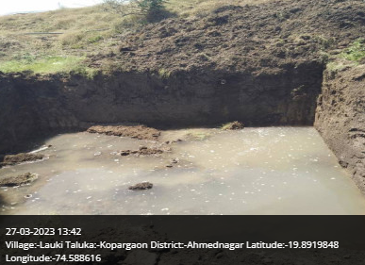
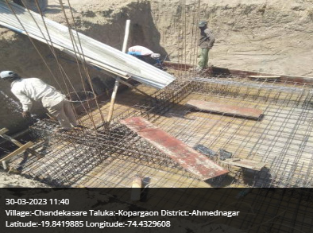
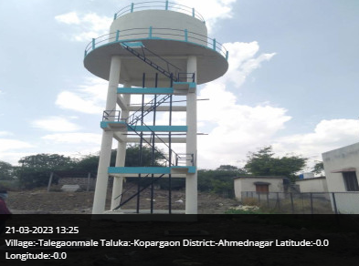
Kopargaon Taluka

Slide 30
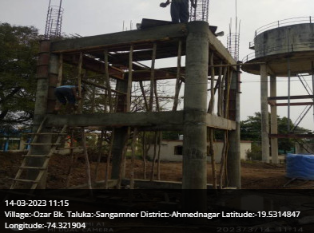
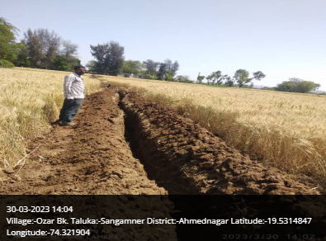
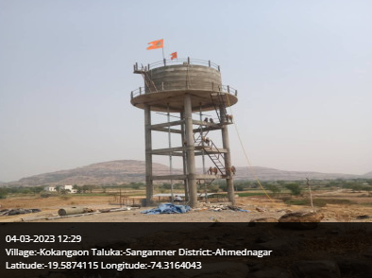
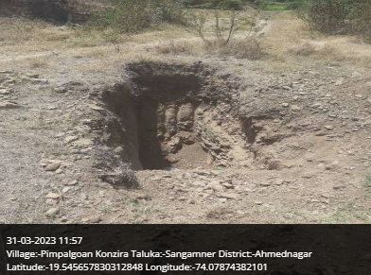
Sangamner Taluka

Slide 31
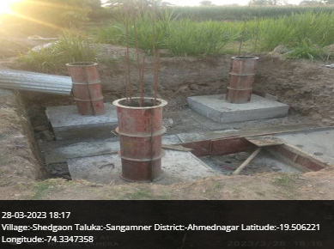
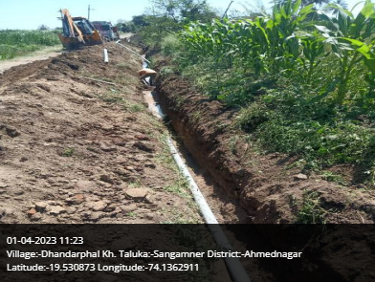
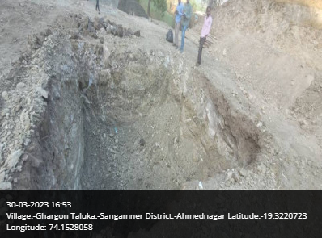
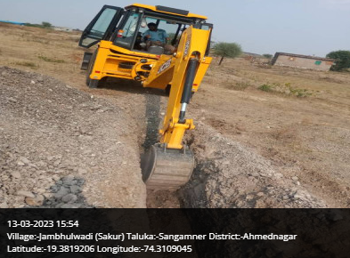
Sangamner Taluka

Slide 32
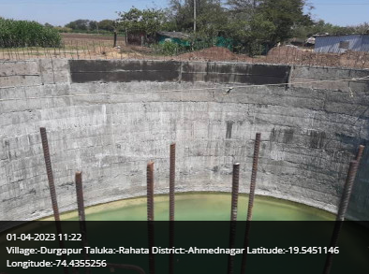
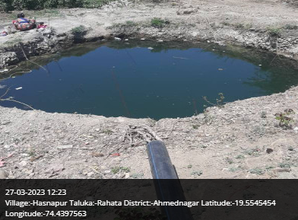
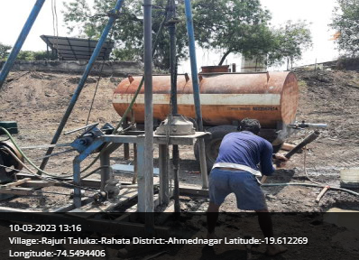
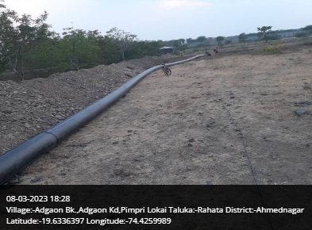
Rahata Taluka

Slide 33
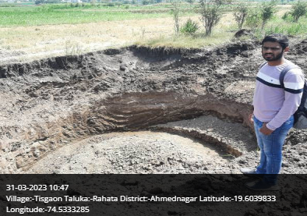
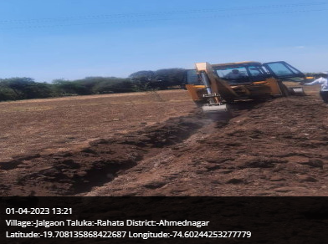
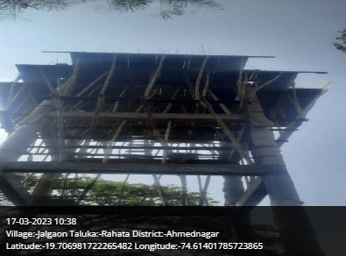
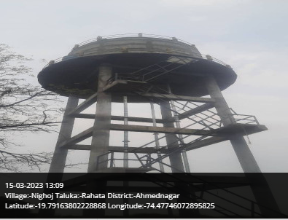
Rahata Taluka

Slide 34
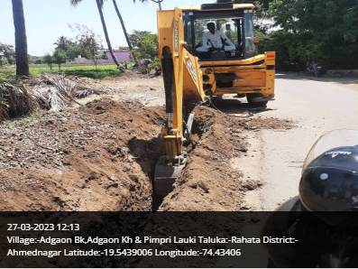
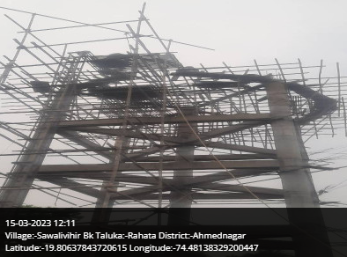
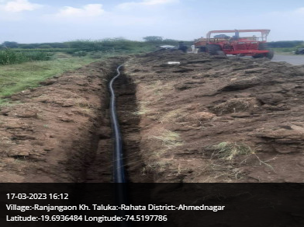
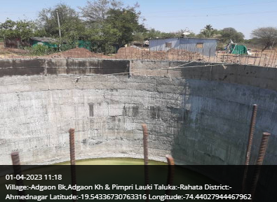
Rahata Taluka

Slide 35

Thank You!

